Slide 1
AHP Internship Model
Dietetics-Physiotherapy-Speech & Language Therapy

Slide 2
Background: Speech and Language Therapy (SaLT) HEIs in Central Belt: Students have limited placement experience of NHSG Physio/Dietetics/SaLT Aim to give current students a different experience from clinical placement, Showcase NHSG/ ACHSCP AHP teams as a great place to work, Support teams with HCSW cover over summer months

Slide 3
2019
Physio Lead collaboration with RGU course lead
Advert in RGU. Interview and selection process
2022
Dietetics followed similar process to physio
Employed 5 first to forth year students on Bank
2023
SaLT- Accidental Intern: Student employed as bank HCSW
SLT pan Grampian collaboration to offer 5 internships
Advertised in all UK HEIs offering SaLT degree option
Offered 12 weeks fixed term post over two areas for varied experience
Offered 12 week fixed term contracts

Slide 4
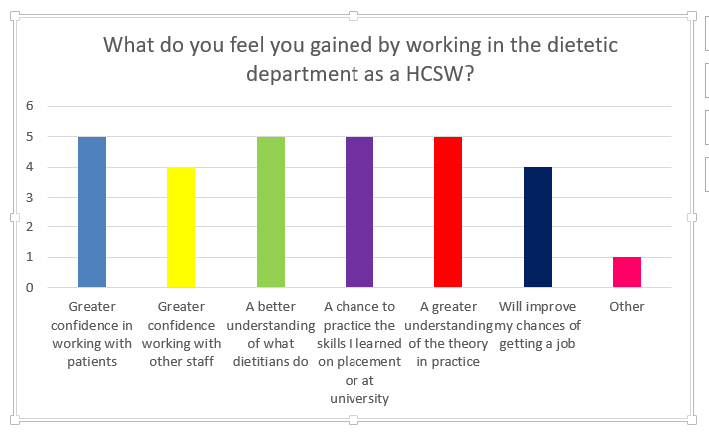
Intern Feedback/ Outcomes
Getting to understand what sorts of things I may be doing as a dietitian in the future.
Great bridge to becoming an autonomous and responsible practitioner
Great to have a chance at working after a long gap between placements
I feel that my positive experience throughout completion of the internship, through gaining experience in so many areas and networking with a number of qualified physiotherapists encouraged me to then apply for a band 5 post with NHSG
I was able to apply the skills, knowledge and experience gained to help me in the completion of my final placements and application for band 5 posts
I feel my experience in the department was key in helping me to get the dietetic role I currently hold

Slide 5
Staff Feedback / Service Outcomes
Resulted in recruitment of NQP from English Uni
Increased profile of NHSG SaLT across all UK HEIs
Supported staff through vacancy and periods of leave
Increased skills and confidence of interns
It helps us with our caseload and gives them experience prior to graduating
a great help with care home reviews and helped to relieve clinical pressures
Had a good experience, very efficient and thorough.

Slide 6
What Next?
Annual review at UPCs to discuss financial position for internships
Add to Jobtrain and advertise locally (and nationally for SaLT)
Offers to successful candidates
Internships commence June/July
Internships end Sept/Oct. Gain feedback

