Slide 1
Aberdeen City Hospital at Home
Thursday 29th February 2024
Sara Knight, Physiotherapist
Valerie Barrett, Nurse Practitioner
Dr Catie Butchart, Clinical Lead Geriatrician
Mhairi Paton – Interim Deputy Chief Nurse

Slide 2
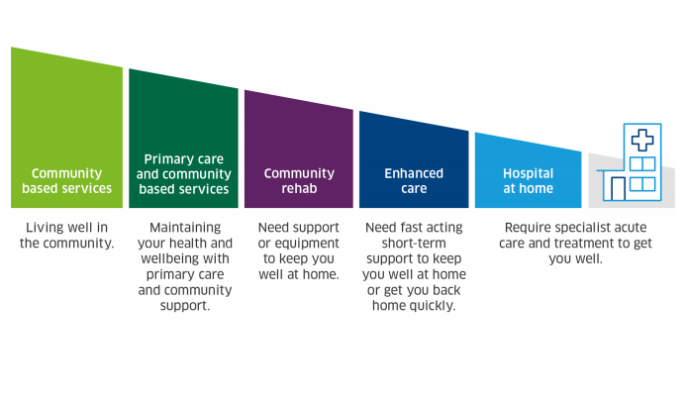
Hospital at home

Slide 3
Hospital at Home
Hospital level care
In a patient’s home
Short episode
Consultant led
Multidisciplinary
Manage acute conditions
Rapid access to investigations

Slide 4
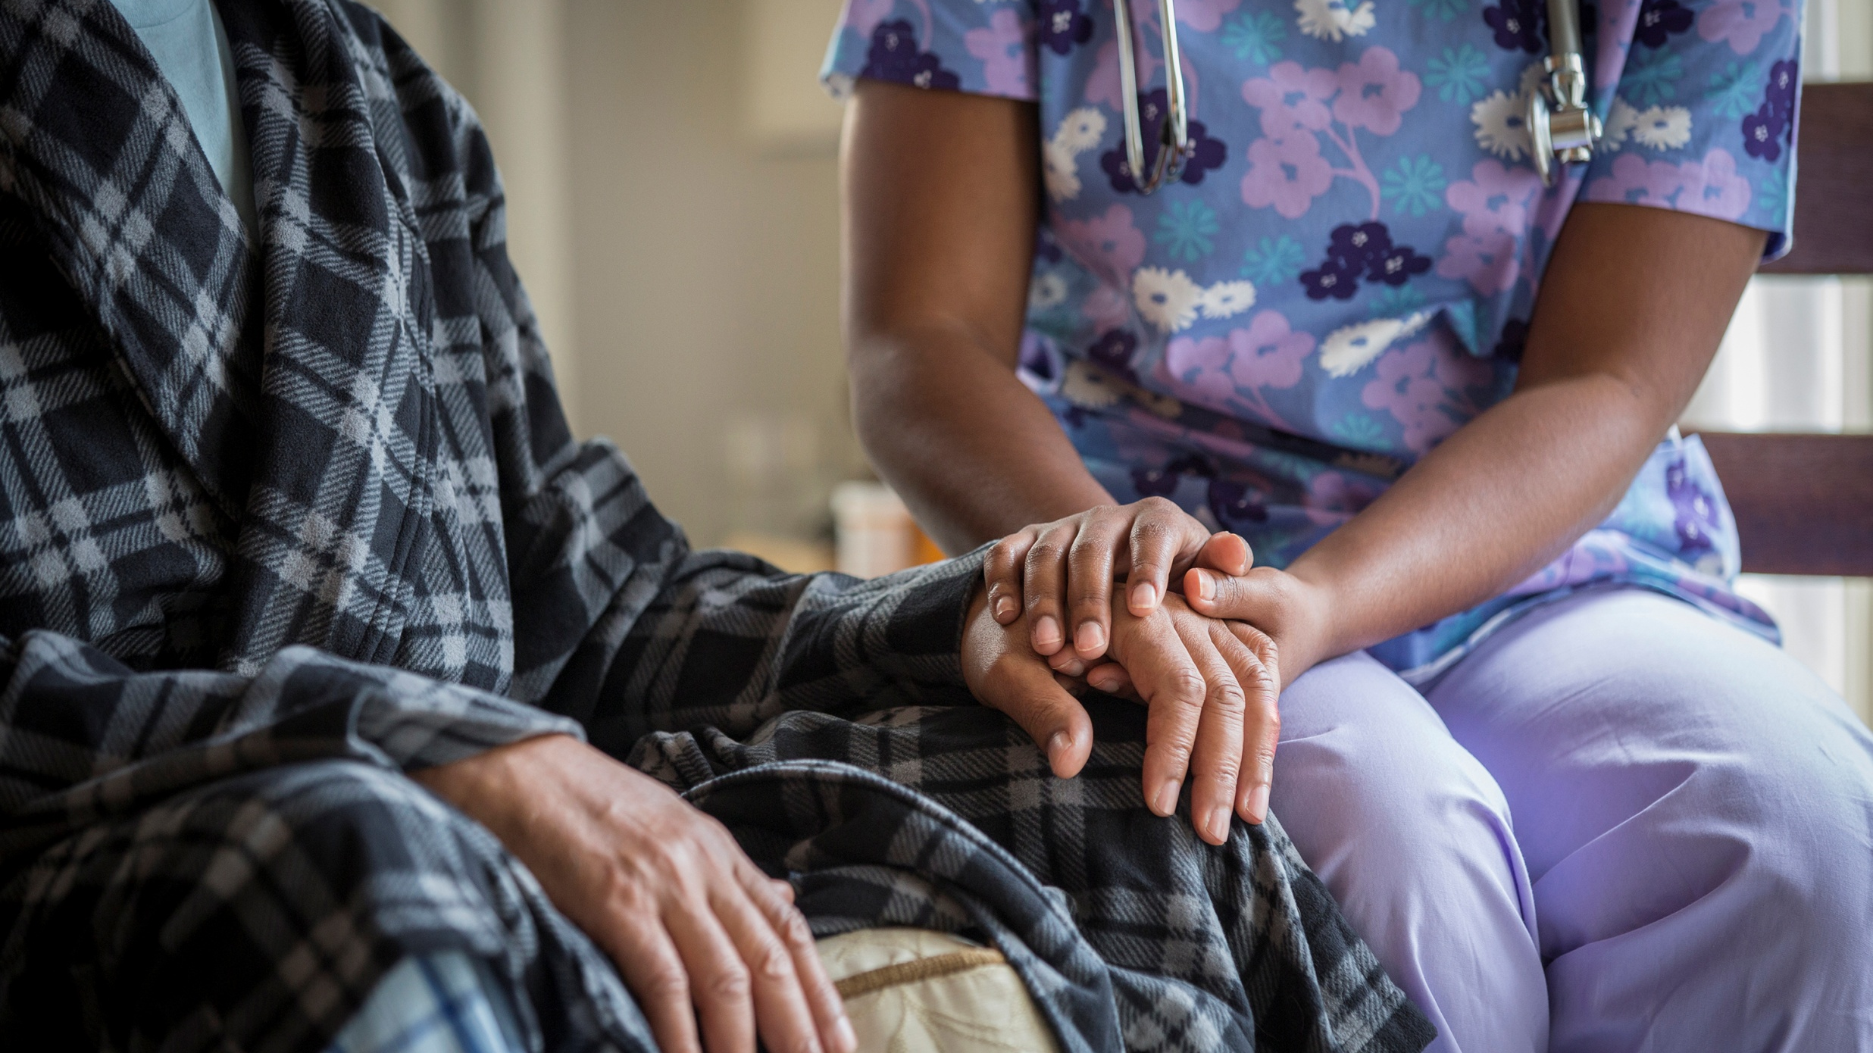
H@H – Current Position
Consultant-led care within the MDT
MDT: OTs, PTs, SALT, dietetics, ANPs, NPs, PAs, GP, FY2, pharmacy technicians, SNs, HCSWs, admin
Hours of work 0800-2015, 7 days a week – links with OOH
Frailty + respiratory + OPAT virtual beds – ongoing recruitment to support scale-up
Staff base at Woodend Hospital
Patients admitted to virtual beds via referral:
- Alternative to admission (to hospital)
- Active recovery (supported discharge from
hospital)
IT systems – TrakCare; MORSE (electronic notes)

Slide 5
Hospital at Home Aberdeen City
What our City H@H service is not:
Social care packages
Routine/planned care
Community Nursing/AHP services

Slide 6
Referral Criteria
Referrals to Hospital at Home should be considered for a patient who:
presents with an acute medical issue and frailty is present
has recently been admitted to ward 107/303, ARI with a respiratory issue
requires intravenous antibiotic therapy
has appropriate care and mobility to remain safe at home
Consultants will assume Clinical Responsibility for all patients admitted to the H@H service.
We aim to see new referrals on the day.

Slide 7
Examples of conditions which can be managed well at home include:
Heart failure – monitoring of oedema, renal function and medical titration
Respiratory illness e.g. infective exacerbations (COPD, bronchiectasis) , management of oxygen therapy
Chronic conditions with acute exacerbations
Acute delirium
Acute functional decline with potential medical cause
Infections requiring IV antibiotics – maximum of twice daily, caseload dependent

Slide 8
Referrals not appropriate for H@H:
Referrals which are solely for OT/PT, pulmonary rehab or social care
Routine requirements e.g., regular subcutaneous injections, INR/anti-coagulant dosing, or wound care
Patients for end-of-life care
Stroke, acute coronary syndromes, or suspected DVT
Suspected hip or lower limb fractures
Surgical presentations e.g., acute abdomen

Slide 9
Logistics
Rapid access to:
Investigations i.e. Bloods (POCT), ECGs, bladder scans, radiology, functional assessment
Treatments i.e. medications, IV fluids, antibiotics, oxygen, occupational therapy, physiotherapy, airway clearance, anxiety management, breathlessness management
Equipment i.e. hospital beds, commodes, walking aids, equipment to support ADLs e.g. toilet frames/bed leavers
All patients receive:
Assessment by the full MDT as required (Comprehensive geriatric assessment for patients with frailty)
Daily reviews
Twice daily MDT discussion
AHP intervention
Daily NEWS monitoring
Falls screening and subsequent assessment where indicated
Medicine reconciliation
Nutrition screening

Slide 10
Case Study– “Sandra” Age 77
Lives alone in a 2nd floor flat in Aberdeen
Usually independent, no services
Daughter lives nearby but has a full-time job and a young family.
1 month increased shortness of breath
Also breathless at night, struggling to sleep
Known Heart Failure and Atrial Fibrillation
Fatigued and struggling with daily tasks
Scared of getting sent to hospital

Slide 11
Case Study– “Sandra” Age 77
Sandra’s GP referred to H@H
Alternative to admission:
Difficult to manage heart failure
- concern due to renal function and low potassium

Slide 12
Case Study– “Sandra” Age 77
Initial Assessment – ANP from H@H
Noted to be breathless after mobilising
Diagnosis – ongoing issue with heart failure
Needing management of heart failure with careful monitoring of bloods
Bloods and ECG obtained
Same day – Joint PT/OT assessment
- ?bath board, ?toilet frame
- ?kitchen trolley
- given stick for outdoors
- plan for stairs assessment
- plan to work on energy conservation
- discussed trip hazards

Slide 13
Case Study– “Sandra” Age 77
Day 2
Senior medical face to face review:
- adjusted heart failure medications
- reviewed bloods and ECG
- made plan for ongoing medical monitoring
Further OT input:
- bath board & kitchen trolley supplied
- grab rail ordered for bathroom
- educated on energy conservation
- educated on anxiety management techniques

Slide 14
Case Study– “Sandra” Age 77
Day 3
Further check of medications from Pharmacy Tech
Further PT visit:
- practicing with kitchen trolley
- stairs assessment
- breathing control exercises
Bloods repeated by HCSW
- reviewed by medical team - stable

Slide 15
Case Study– “Sandra” Age 77
Day 4
HCSW visit to check NEWS and general progress
Sandra bright and happy
NEWS stable, no concerns
Day 5
HCSW noted Sandra was very anxious and dizzy
Bloods repeated
Then seen again by ANP
- clinically stable
- reinforced anxiety management techniques
- discussed possible discharge tomorrow
- bloods reviewed - stable

Slide 16
Case Study– “Sandra” Age 77
Day 6 - DISCHARGE
- HCSW visit – anxiety settled, clinically stable
- OT visit – reinforced breathing techniques and anxiety management
- Pharmacy Tech – final review of medications
Outcomes:
- improved heart failure symptoms
- independence maintained
- increased ability to manage anxiety
- improved energy conservation
- increased confidence
- optimised mobility, incl outdoors

Slide 17
Sandra's feedback

Slide 18
What matters to you? Job satisfaction
What do our staff enjoy about working about Hospital at Home.
"It is lovely driving about between patients rather than being stuck in a ward.
I have time to spend with patients and their families to give explanation and reassure them.
Enjoy working closely with the MDT
Seeing patient in their own environment
Refreshing environment and such a contrast to secondary care, patients are happy and so grateful to be at home"
AIMS Public Health, Karacaoglu & Leask, 2021
High job satisfaction was reported (mean score 73%), particularly due to a perceived non-hierarchical team structure and inclusive management style. Staff attributed positive outcomes through better identifying patients' needs at home compared to in hospital.
Fridberg, H, Wallin L, Tistad, M BMC Health Servcie Res, 2021; 21:904, Google Scholar
The HCPs experienced enhanced joy from the improved connections with patients and increased energy when they could meet patients’ needs.

Slide 19
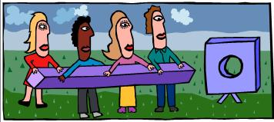
"Although challenging place to work. I enjoy being part of a team building Hospital at Home for the future and firmly believe in the challenge for many reasons. I have enjoyed watching the service blossom from a handful of patients to the exciting place we are in now"
Pharmacy technician. Hospital at Home 2024

Slide 20
Respiratory
Acute Medicine TOC
Orthopaedics
Paediatrics
Surgical – Early Supported Discharge

Slide 21
Visit our table to collect your free raffle ticket! Your suggestions and feedback are valuable to us.

Slide 22
Thank you
www.hospitalathome.org.uk
Tel: 01224 556055
gram.hospitalathomeadmin@nhs.scot

