Slide 1
Notes:
Iain Robertson, TPM – Communities within ACHSCP – Present an overview of Grampian Wellbeing Festival to be held during the month of May. And set out why wellbeing is becoming increasingly important to ACHSCP and wider health and social care system across Aberdeen City and Grampian-region

Slide 2
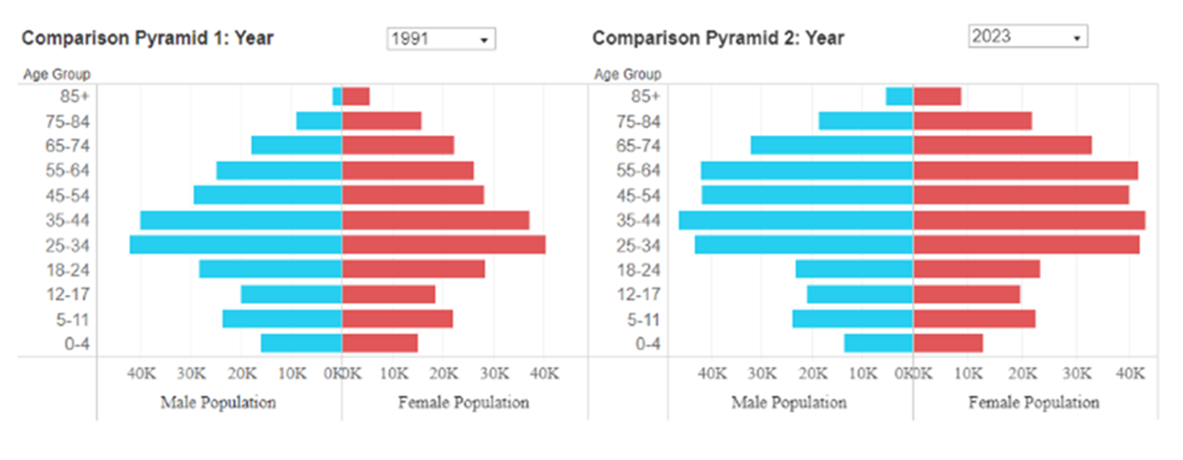
Why Wellbeing Matters?
Notes:
Impact and aftermath of covid-19 pandemic on mental health and wellbeing
Increase in cost of living, inflation, financial hardship, mortgage repayments and increasing rents
More health inequalities, most deprived population spending a third of their lives in poor health
Ageing Population, the multiple co-morbidities and greater complexity
WHO declared a Loneliness epidemic last year – social isolation and poor wellbeing
Technology is rapidly changing the way or lives are, they can support us – uber, Alexa, QR codes but also exclude us too
Climate change and importance of access to green space/nature - repeatedly shown to improve mental health and reduce feelings of anxiety and depression.
Median Return of Investment for public health interventions was £14 saved to every £1 invested – British Medical Journal

Slide 3
Stay Well Stay Connected - Five Ways of Wellbeing
Notes:
Wellbeing Team in position, 4 wellbeing coordinators who will be well known to many of you – work on locality basis
Promote wellbeing in our Workforce and service users
Promote social engagement
Increase the quality of time spent with others
Develop friendships and meaningful relationships
To maintain sensory awareness and ability to encourage communication and self-expression
Promote a sense of feeling cared for and caring for
To promote a sense of self-worth and a sense of value and importance

Slide 4
Events
26 single events
Hosts
78
1500+
Participants
Activities
166 events
95 Multiple events
4 large events
Running for 8 years in Aberdeenshire
New for 2024 Aberdeen City and Moray
Mascot competition in Moray and Aberdeenshire schools
Notes:
Grampian Festival will be bigger and better

Slide 5
Aims
Wide range of events
Promote local organisations
Inclusive, accessible and free
No Age restrictions
Raise awareness of MH and Well-being opportunities locally
Encourage volunteering

Slide 6
Focus for ACHSCP – Grampian Wellbeing Festival
Flagship event Grampian Meaningful Activity Network (GMAN) festival, partnership working in care home sector
Post pandemic event to map what is available in the city
Promote ALISS and benefits of groups managing their contact information
Promotion of activities and event throughout the year
Promote Mental Health Awareness Week, Scottish Learning Disability Awareness Week, Dementia Week, Demystifying Death Week
Focus on Workforce Mental Health and Wellbeing
Notes:
ALISS is a national digital programme enabling people and professionals to find and share information on resources, services, groups, and support in their local communities and online.
ALISS can help you find information about resources like:
services that provide support for managing long term conditions
groups that support social and community connection (e.g., local choirs, book groups, befriending)
activities that offer opportunities for getting more active and for getting outdoors (e.g., badminton clubs, community gardens)
practical, legal, and financial support (e.g., money advice, advocacy services)
digital technology that can support health and social care (e.g., online forums, health related mobile apps).
ALISS aims to ensure that everyone in Scotland has the right information, at the right time, about resources that are available to help them live well and stay connected to their community.

Slide 7
“To reduce demand on the whole health and care system, public health and preventative health care measures need to be prioritised”
Audit Scotland
Notes:
In closing key message– wellbeing is no longer a nice to have – its integral to the delivery and sustainability of our health and social care system, and vital to the health and happiness of all people across Grampian

